Slide 1

SAI VIDYA INSTITUTE OF TECHNOLOGY Accredited by NBA New Delhi (CSE, ECE, ISE, MECH, CIVIL), NAAC-“A” Grade
Department of Computer Science and Engineering
Rajanukunte, Bengaluru - 560064
Project Presentation- 2023-24
A Smart Recommendation System for Carrier-Shipper Matching using Multilabel Classification
By
Aastha Prasad 1VA20CS001
S G Dhanush Kumar 1VA20CS043
Sharan S 1VA20CS049
Danush V S 1VA20CS069
Under the guidance of :
Dr. Tejashwini N Dr. Varun E
Associate Professor Associate Professor
Dept. of computer science and engineering Dept. of computer science and engineering

Slide 2
Contents
Introduction
Problem Statement
Literature Survey
System Requirement Specification
System Architecture
System Design
Conclusion
References
Dept. of CSE, SVIT 2

Slide 3

Introduction
The "Smart Recommendation System for Carrier Shipping Matching" is a sophisticated solution designed to streamline the process of selecting the optimal shipping carrier for each package.
Leveraging a combination of historical data, real-time tracking and advanced machine learning techniques, this system aims to provide users with accurate and data-driven carrier recommendations that align with their specific shipping requirements.
Dept. of CSE, SVIT 3

Slide 4

Problem statement
“Design and implement an intelligent recommendation system that can efficiently match carriers (freight transportation providers) with shippers (companies or individuals looking to ship goods) based on their specific needs, preferences, and operational constraints. The system should take into account various parameters, such as cargo type, delivery timeline, geographical location, carrier capacity and pricing.”
Dept. of CSE, SVIT 4

Slide 5
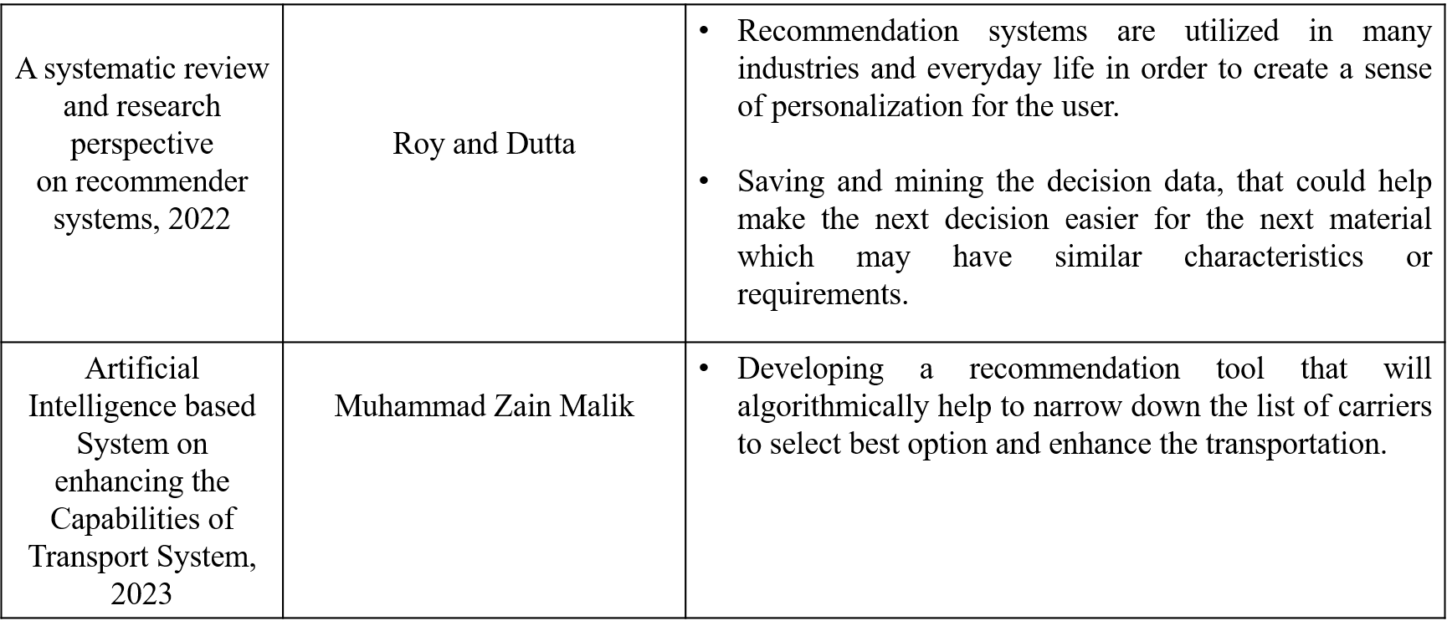
Literature Survey
Dept. of CSE, SVIT 5

Slide 6
Literature Survey
Title | Author | Key Findings
A Recommendation System for Carrier-Shipper Matching, Based on supply chain mechanism, 2022 | Lauren Jennifer Fellin | 3 Phase Selection Criteria: General availability Criteria based filtration Key sub-criteria Automate the process and start leveraging the analysis of both the historical and real-time data to continuously improve carrier-shipper matching
Other Recommendation systems | Netflix, movie streaming service is a good example of a recommendation systems. | Netflix’s show recommendation system was developed by data mining subscriber star ratings of shows or movies they watched.
Dept. of CSE, SVIT 6

Slide 7
System Requirement Specification
HARDWARE REQUIREMENTS
1.Processor: Intel i5 2.5 Ghz upto 3.5Ghz (or AMD equivalent)
2. GPU (preferred): dedicated GPU from NVIDIA or AMD with 4GB VRAM
3. Memory: minimum 8GB RAM
4. Secondary Storage: minimum 128GB SSD or HDD
5. Network Connectivity: bandwidth ~ 10 Mbps
Dept. of CSE, SVIT 6

Slide 8
SOFTWARE REQUIREMENTS
SOFTWARE REQUIREMENTS
1. Operating System: Operating system acts as the interface between the user
programs and the kernel. Windows 8 and above (64 bit) operating system is
required.
2. Anaconda: Anaconda is a free and open-source distribution of the Python and
R programming languages for scientific computing, that aims to simplify
package management and deployment.
3. Jupyter Notebook: The Jupyter Notebook is an open-source web application
that allows you to create and share documents that contain live code, equations,
visualizations and narrative text.
4. Data Set: The dataset contains details of shipper and consignee characterized by shipping parameters
Dept. of CSE, SVIT 6

Slide 9
SOFTWARE REQUIREMENTS
FUNCTIONAL REQUIREMENTS
11. Data Pre-processing: This process involves cleaning, transforming and
reducing data to convert raw data in a useful manner.
2. Training: Initially, the system has to train based on the data set given. The
training period is when the system learns how to perform the required task
based on the inputs given through the dataset.
3. Forecasting: Forecasting is the process of making predictions of the future
based on past and present data and most commonly by analysis of trends.
4. Evaluation: In order to know whether the system is working efficiently, the
song that has been generated is again passed into the classifier to determine
the kind of song that it has generated. This is necessary in order to determine the accuracy of the system.
Dept. of CSE, SVIT 6

Slide 10
SOFTWARE REQUIREMENTS
NON-FUNCTIONAL REQUIREMENTS
1. Accuracy: This refers to the number of correct outputs to the total number of outputs.
2. Openness: The system must be guaranteed to work efficiently for a certain period of time.
3. Portability: The system must be designed in a way which is independent of the platform on which it is run. This makes it possible to run on many systems without making a lot of changes.
4. Reliability: The system has to produce fast and accurate results.
Dept. of CSE, SVIT 6

Slide 11
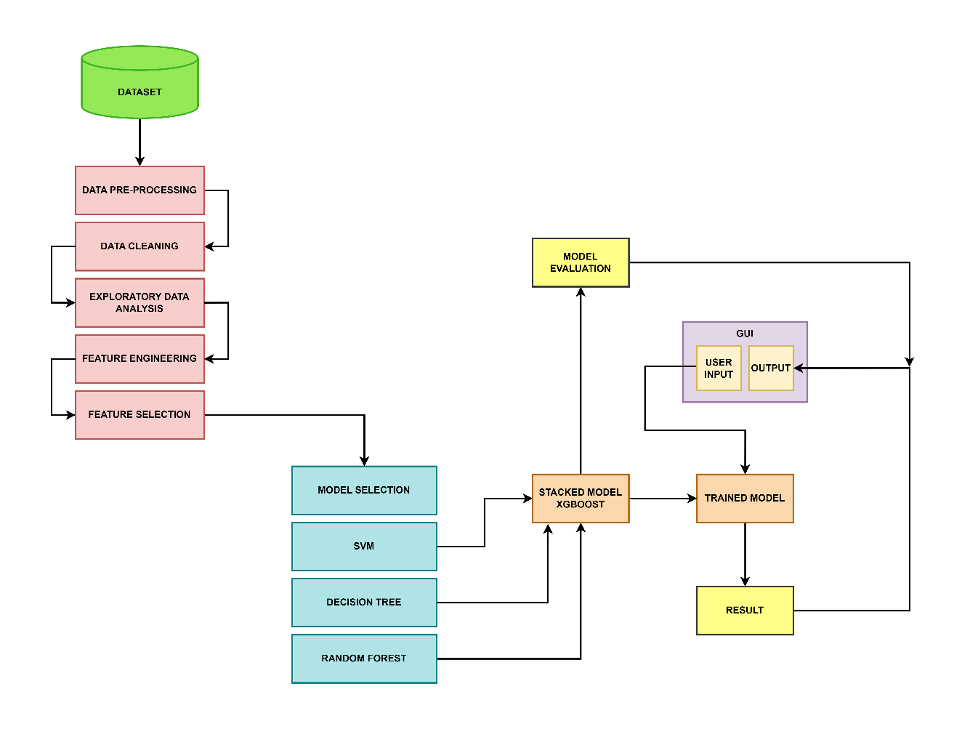
System Architecture
Dept. of CSE, SVIT 6

Slide 12
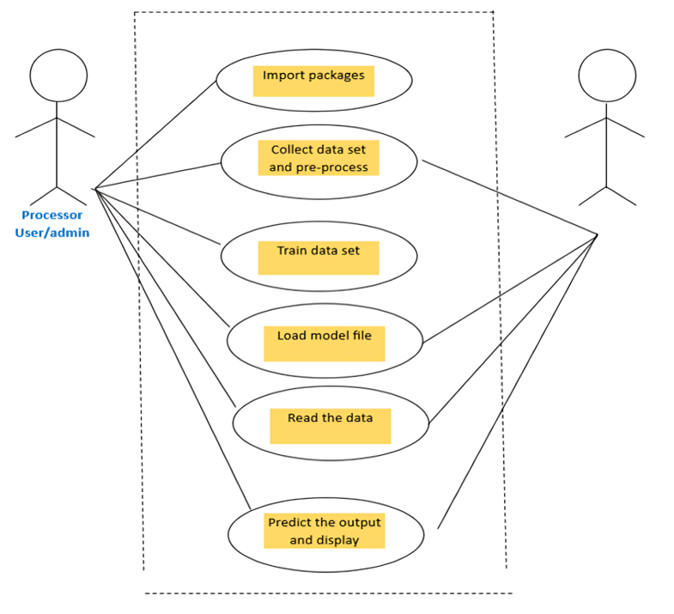
Usecase Diagram
Dept. of CSE, SVIT 6

Slide 13
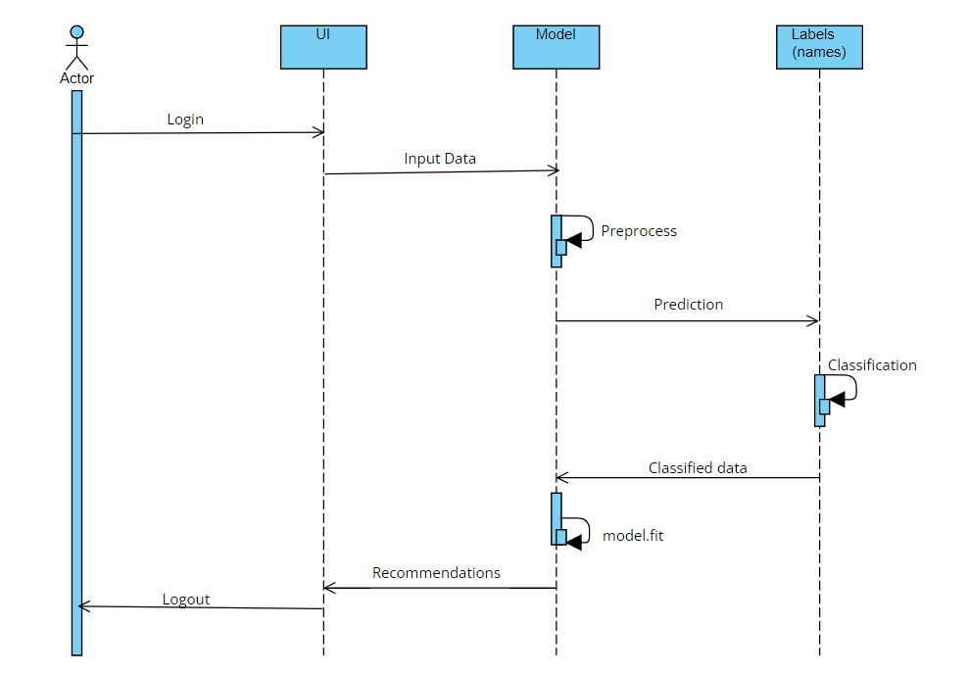
Sequence Diagram
Dept. of CSE, SVIT 6

Slide 14
Implementation
import numpy as np
import pandas as pd
import matplotlib.pyplot as plt
import seaborn as sns
print('[info] all packages imported successfully...')
# **1. DATA COLLECTION**data = pd.read_csv('carrier_shipment_data.csv')
data.head(3)
Dept. of CSE, SVIT 6

Slide 15
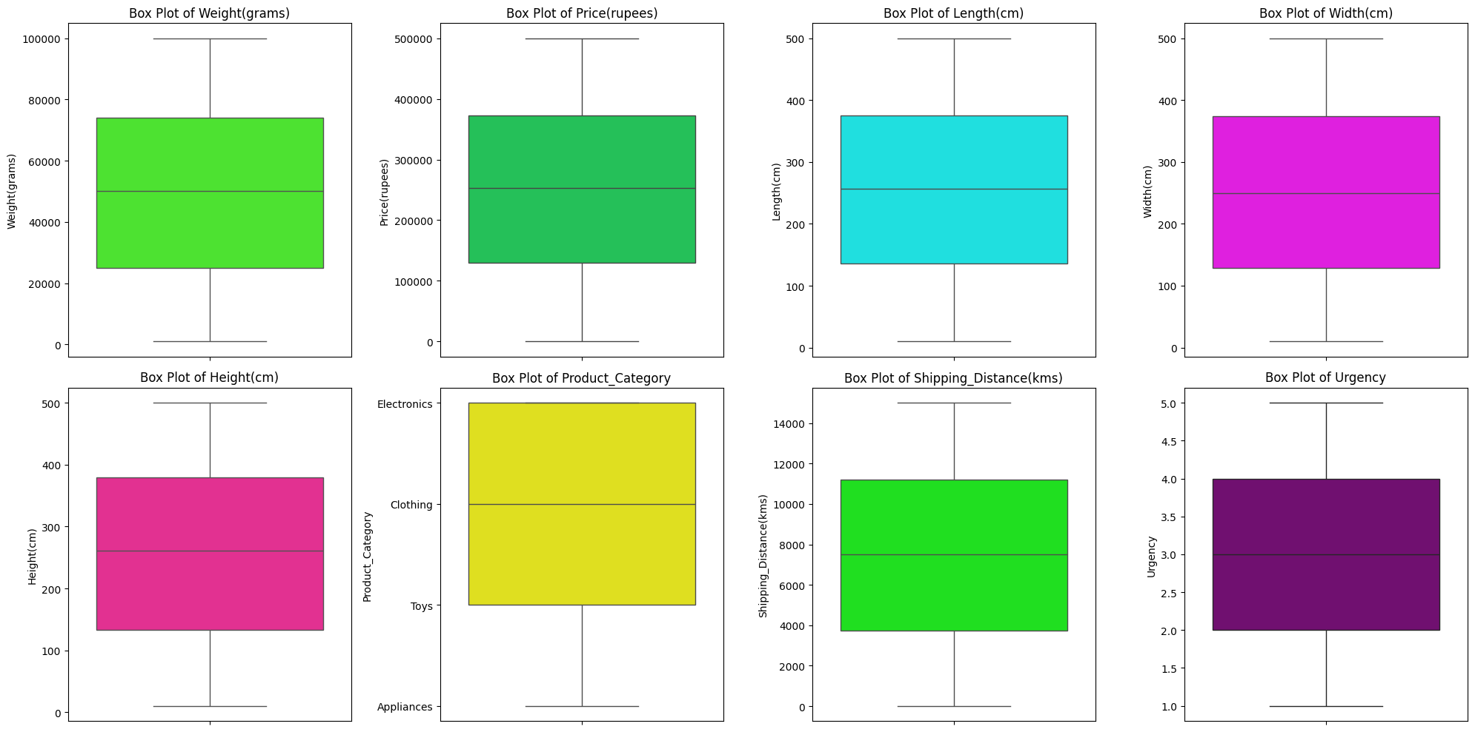
Implementation
import pandas as pd
import seaborn as sns
import matplotlib.pyplot as plt
# Read the CSV file
data = pd.read_csv('carrier_shipment_data.csv')
# Set custom neon colors
neon_colors = ['#39FF14', '#0BDA51', '#00FFFF', '#FF00FF', '#FF1493', '#FFFF00', '#00FF00', '#800080']
# Create a figure and axis objects
fig, axs = plt.subplots(2, 4, figsize=(20, 10))
# Plot box plots for each feature except "Fragility"
features = [col for col in data.columns[:-1] if col != 'Fragility'] # Exclude 'Fragility' column
for i, feature in enumerate(features):
sns.boxplot(y=feature, data=data, palette=[neon_colors[i]], ax=axs[i // 4, i % 4])
axs[i // 4, i % 4].set_title(f'Box Plot of {feature}')
# Remove empty subplots if any
for i in range(len(features), 8):
axs[i // 4, i % 4].remove()
# Adjust layout
plt.tight_layout()
plt.savefig(r'carriershipmentnew/static/eda_plots/eda_1.png')
# Show plots
plt.show()
Dept. of CSE, SVIT 6

Slide 16
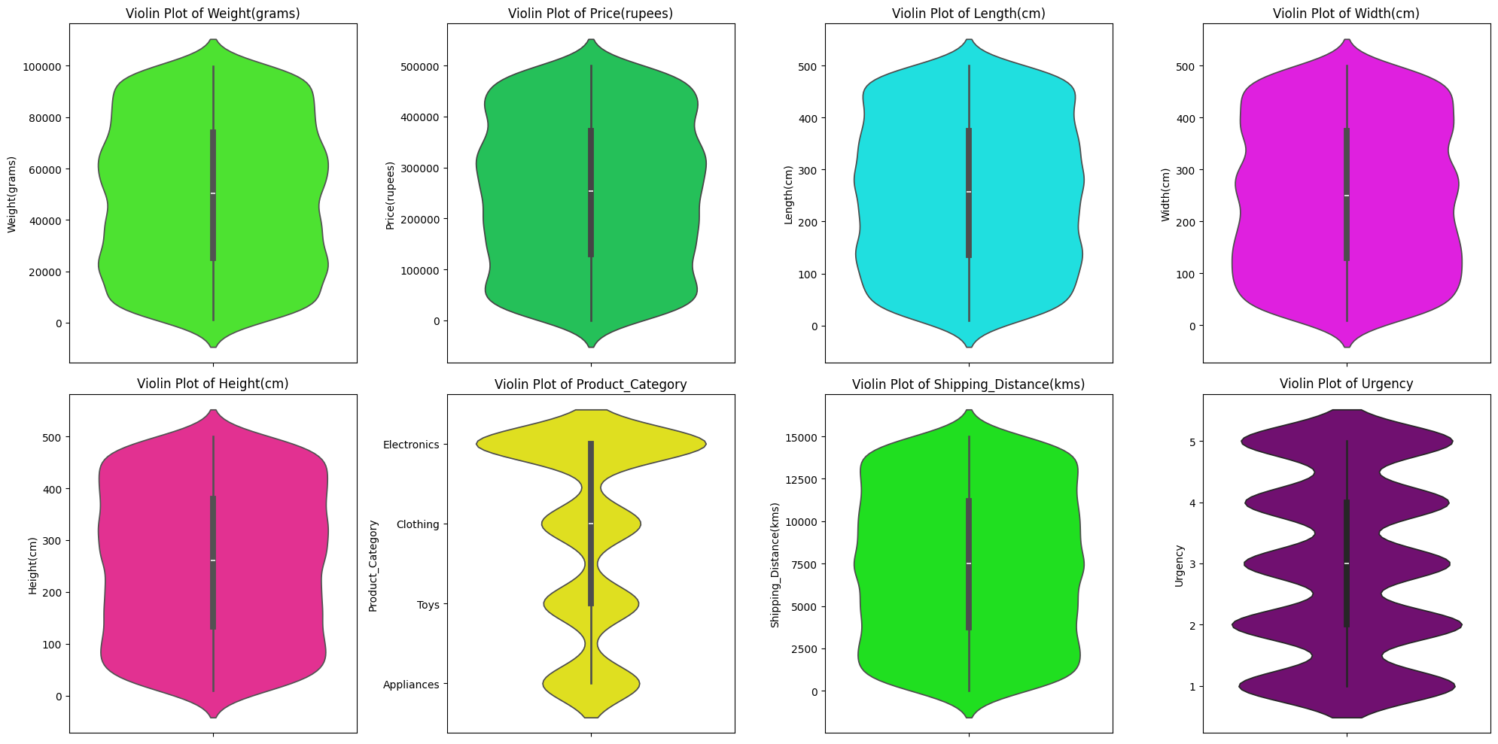
Implementation
import pandas as pd
import seaborn as sns
import matplotlib.pyplot as plt
# Read the CSV file
data = pd.read_csv('carrier_shipment_data.csv')
# Set custom neon colors
neon_colors = ['#39FF14', '#0BDA51', '#00FFFF', '#FF00FF', '#FF1493', '#FFFF00', '#00FF00', '#800080']
# Create a figure and axis objects
fig, axs = plt.subplots(2, 4, figsize=(20, 10))
# Plot violin plots for each feature except "Fragility"
features = [col for col in data.columns[:-1] if col != 'Fragility'] # Exclude 'Fragility' column
for i, feature in enumerate(features):
sns.violinplot(y=feature, data=data, palette=[neon_colors[i]], ax=axs[i // 4, i % 4])
axs[i // 4, i % 4].set_title(f'Violin Plot of {feature}')
# Remove empty subplots if any
for i in range(len(features), 8):
axs[i // 4, i % 4].remove()
# Adjust layout
plt.tight_layout()
plt.savefig(r'carriershipmentnew/static/eda_plots/eda_2.png')
# Show plots
plt.show()
Dept. of CSE, SVIT 6

Slide 17
Implementation
# **3. DATA PRE-PROCESSING**
data.columns = ['Weight(grams)', 'Price(rupees)', 'Length(cm)', 'Width(cm)',
'Height(cm)', 'Product_Category', 'Shipping_Distance(kms)', 'Fragility',
'Urgency', 'Mode_of_Transport']
data.columns = [col.lower() for col in data.columns]product_category_unique = data['product_category'].unique().tolist()
product_category_index = np.arange(0,len(product_category_unique),1)
product_category_text_to_num = {i:j for i,j in zip(product_category_unique,product_category_index)}
product_category_num_to_text = {j:i for i,j in zip(product_category_unique,product_category_index)}
data['product_category'] = data['product_category'].map(product_category_text_to_num)
mode_of_transport_unique = data['mode_of_transport'].unique().tolist()
mode_of_transport_index = np.arange(0,len(mode_of_transport_unique),1)
mode_of_transport_text_to_num = {i:j for i,j in zip(mode_of_transport_unique,mode_of_transport_index)}
mode_of_transport_num_to_text = {j:i for i,j in zip(mode_of_transport_unique,mode_of_transport_index)}
data['mode_of_transport'] = data['mode_of_transport'].map(mode_of_transport_text_to_num)
print('[info] all text labels converted to numbers...')
mode_of_transport_unique
Dept. of CSE, SVIT 6

Slide 18
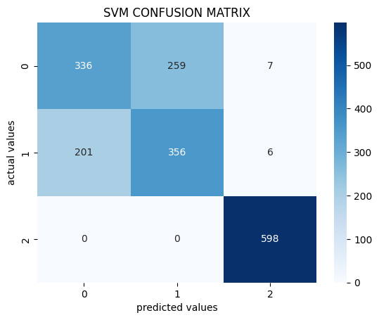
Implementation
#### 4a. SVM from sklearn.svm import SVC#importing algo
svm_model = SVC(probability=True)#initialising the algo
svm_model.fit(x_train_scaled,y_train)#training the algo on our data
print('[info] model training complete...')#using the trained model to predict output for x_test_scaled
svm_pred = svm_model.predict(x_test_scaled)
#comparing actual values with predicted values
from sklearn.metrics import accuracy_score,classification_report, confusion_matrix
print(f"SVM CLASSIFICATION REPORT : \n{classification_report(svm_pred,y_test)}")
import seaborn as sns
import matplotlib.pyplot as plt
svm_cf = confusion_matrix(y_test,svm_pred)
sns.heatmap(svm_cf,cmap='Blues',annot=True,fmt='d')
plt.xlabel('predicted values')
plt.ylabel('actual values')
plt.title('SVM CONFUSION MATRIX')
plt.savefig(r'E:\carriershipmentnew\static\model_parameters\1_svm_confusion_matrix.png',
bbox_inches='tight')
plt.show()
Dept. of CSE, SVIT 6

Slide 19
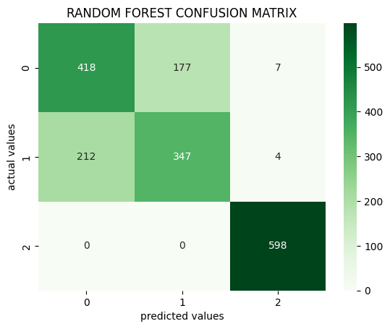
Implementation
#### 4b. RANDOM FOREST from sklearn.ensemble import RandomForestClassifier#importing algo
rf_model = RandomForestClassifier()#initialising the algo
rf_model.fit(x_train_scaled,y_train)#training the algo on our data
print('[info] model training complete...')#using the trained model to predict output for x_test_scaled
rf_pred = rf_model.predict(x_test_scaled)
#comparing actual values with predicted values
from sklearn.metrics import accuracy_score,classification_report
print(f"RANDOM FOREST CLASSIFICATION REPORT : \n{classification_report(rf_pred,y_test)}")
import seaborn as sns
import matplotlib.pyplot as plt
rf_cf = confusion_matrix(y_test,rf_pred)
sns.heatmap(rf_cf,cmap='Greens',annot=True,fmt='d')
plt.xlabel('predicted values')
plt.ylabel('actual values')
plt.title('RANDOM FOREST CONFUSION MATRIX')
plt.savefig(r'E:\carriershipmentnew\static\model_parameters\2_rf_confusion_matrix.png',
bbox_inches='tight')
plt.show()
Dept. of CSE, SVIT 6

Slide 20
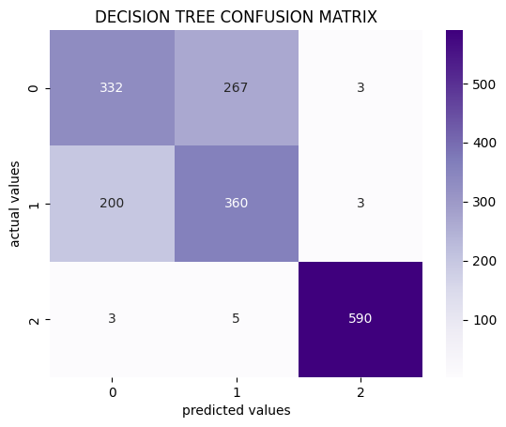
Implementation
import joblib
joblib.dump(rf_model,'2_rf.pkl')#### 4c. DECISION TREEfrom sklearn.tree import DecisionTreeClassifier#importing algo
dt_model = DecisionTreeClassifier()#initialising the algo
dt_model.fit(x_train_scaled,y_train)#training the algo on our data
print('[info] model training complete...')#using the trained model to predict output for x_test_scaled
dt_pred = dt_model.predict(x_test_scaled)
#comparing actual values with predicted values
from sklearn.metrics import accuracy_score,classification_report
print(f"DECISION TREE CLASSIFICATION REPORT : \n{classification_report(dt_pred,y_test)}")
import seaborn as sns
import matplotlib.pyplot as plt
dt_cf = confusion_matrix(y_test,dt_pred)
sns.heatmap(dt_cf,cmap='Purples',annot=True,fmt='d')
plt.xlabel('predicted values')
plt.ylabel('actual values')
plt.title('DECISION TREE CONFUSION MATRIX')
plt.savefig(r‘E:\carriershipmentnew\static\model_parameters\3_dt_confusion_matrix.png',
bbox_inches='tight')
plt.show()
Dept. of CSE, SVIT 6

Slide 21
Implementation
#### implementationimport joblib
svm_model = joblib.load('1_svm.pkl')
rf_model = joblib.load('2_rf.pkl')
dt_model = joblib.load('3_dt.pkl')
hybrid_model = joblib.load('4_hybrid_model.pkl')
print('[info] machine learning models loaded successfully')print('ENTER YOUR PRODUCT DETAILS')
print('-'*27)
# weight = float(input('enter the weight of product in gms : '))
# price = int(input('enter the price of your product : '))
# length = float(input('enter the length of your product in cms : '))
# width = float(input('enter the width of your product in cms : '))
# height = float(input("enter the height of your product in cms : "))
# product_category = float(input("enter product category 'Electronics': 0, 'Clothing': 1, 'Toys': 2, 'Appliances': 3"))
# shipping_distance = int(input("enter shipping distance in kms : "))
# fragility = int(input("is the product fragile?"))
# urgency = int(input("enter urgency of shipment on a scale of 1-5"))
# new_user_input = [[weight,price,length,
# width,height,product_category,
# shipping_distance,fragility,urgency]]
new_user_input = [x[0]]svm_model_output = svm_model.predict(new_user_input)[0]
svm_model_recommendation = mode_of_transport_num_to_text[svm_model_output]
rf_model_output = rf_model.predict(new_user_input)[0]
rf_model_recommendation = mode_of_transport_num_to_text[rf_model_output]
dt_model_output = dt_model.predict(new_user_input)[0]
dt_model_recommendation = mode_of_transport_num_to_text[dt_model_output]
hybrid_model_output = hybrid_model.predict(new_user_input)[0]
hybrid_model_recommendation = mode_of_transport_num_to_text[hybrid_model_output]print(f"svm recommendation : {svm_model_recommendation}")
print(f"decision tree recommendation : {dt_model_recommendation}")
print(f"random forest recommendation : {rf_model_recommendation}")
print(f"hybrid model recommendation : {hybrid_model_recommendation}")
Dept. of CSE, SVIT 6

Slide 22
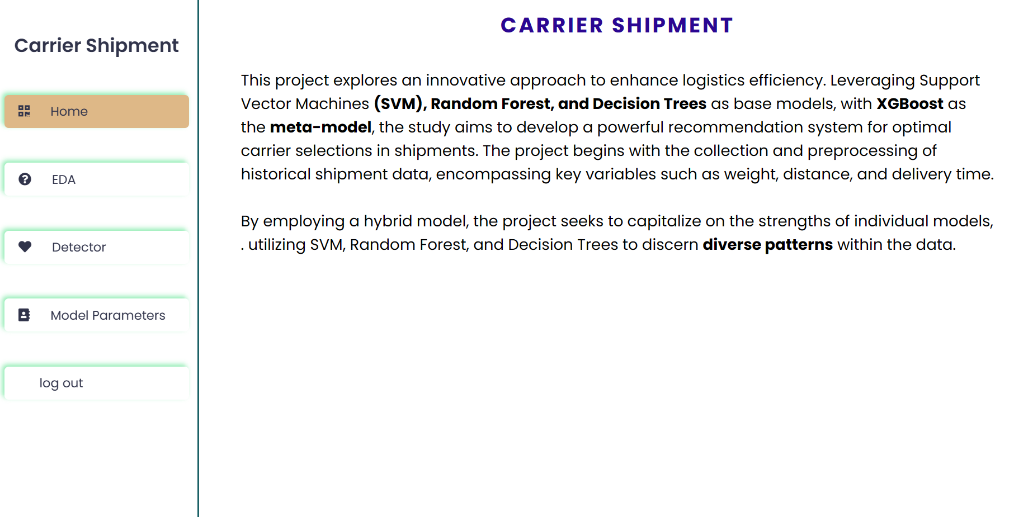
Screenshots
Dept. of CSE, SVIT 6

Slide 23
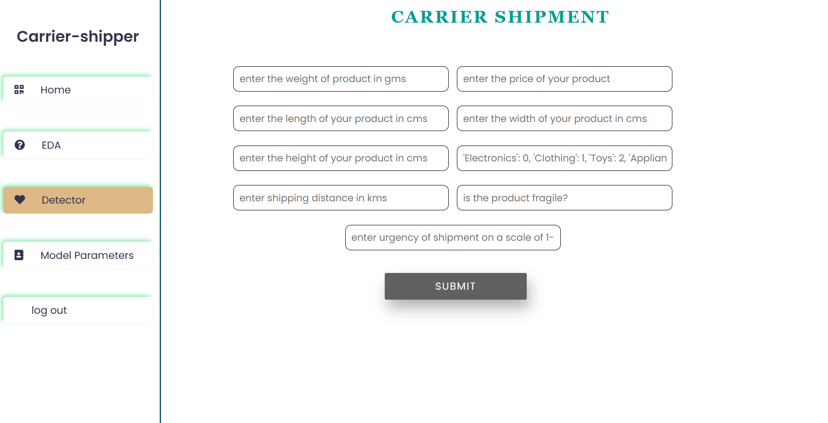
Screenshots
Dept. of CSE, SVIT 6

Slide 24
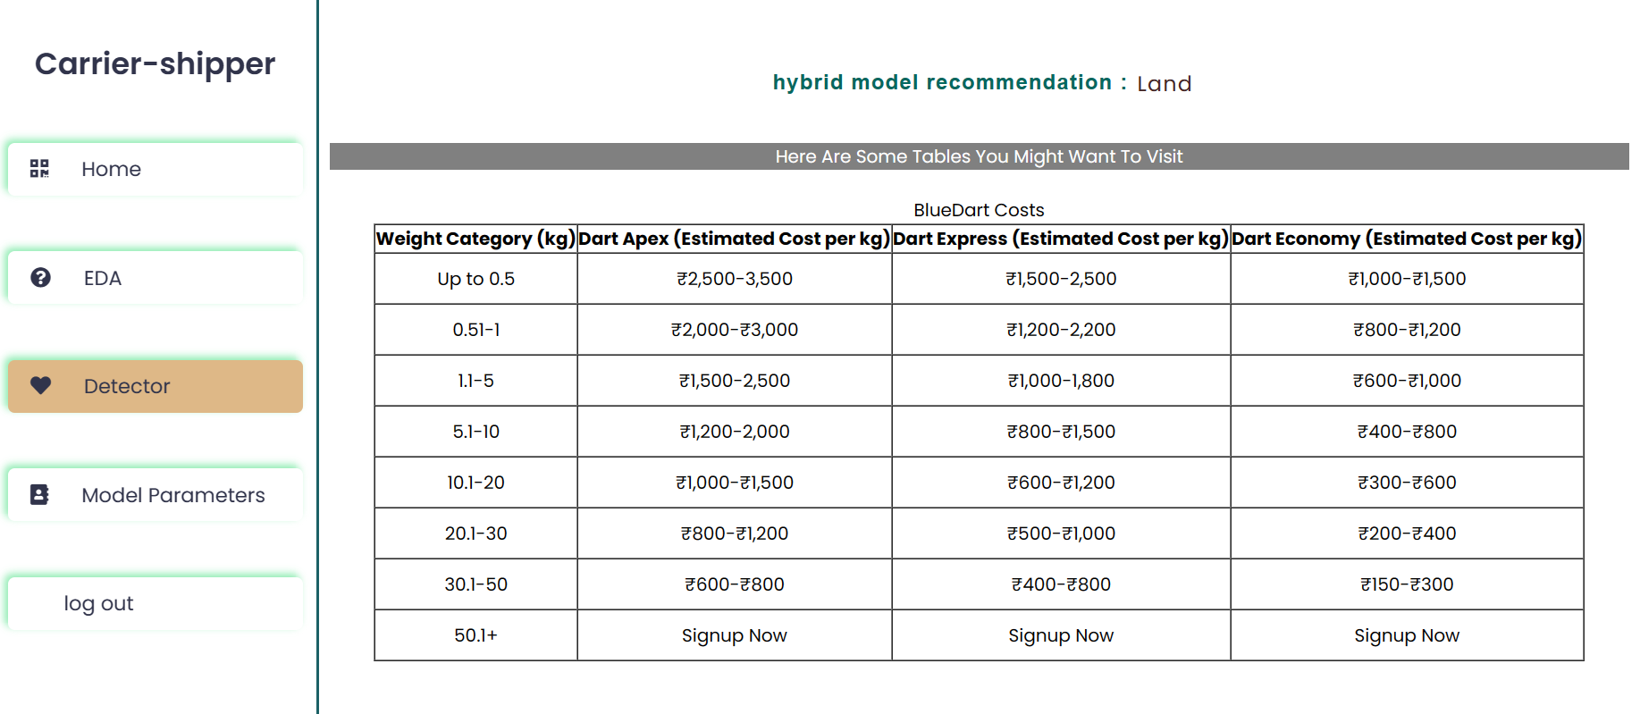
Screenshots
Dept. of CSE, SVIT 6

Slide 25
Future Work
Advanced Algorithm Selection: Evaluate and incorporate state-of-the-art algorithms for multilabel classification that are better suited to the specific requirements and complexities of carrier-shipper matching.
Real-time Data Integration: Implement mechanisms to seamlessly integrate real-time data into the recommendation system. This could involve establishing connections with APIs or data streams that provide up-to-the-minute information
Dynamic Model Updating: Implement mechanisms for dynamically updating the recommendation model based on feedback from previous matches, changing market conditions, and evolving business requirements.
Scalability and Performance Optimization: Optimize the system architecture and algorithms to ensure scalability and efficient processing of large volumes of data, particularly as the platform grows in terms of the number of users, transactions, and geographical coverage.
Dept. of CSE, SVIT 6

Slide 26
Conclusion
Innovation and Significance:
Our Smart Recommendation System introduces innovative solutions to the complex task of Carrier-Shipper Matching.
It significantly enhances efficiency, reduces costs and optimizes resource allocation.
Data-Driven Decision Making:
We have demonstrated the power of data-driven decision-making, which allows for real-time adjustments and proactive problem-solving.
Dept. of CSE, SVIT 26

Slide 27
References
Roy and Dutta, “A systematic review and research perspective on recommender systems”, Journal of Big Data ,2022.
Muhammad Zain Malik, “Artificial Intelligence based System on enhancing the Capabilities of Transport System: A Systemic Literature Review” 023 IEEE Symposium on Industrial Electronics & Applications (ISIEA) 2023 IEEE Ali Yahyaouy, Deep Based Recommender System For Relevant K Pick-up Points, IEEE Xplore.
R.Santhiya, Machine Learning Techniques for Intelligent Transportation Systems-An overview, 12th International Conference on Computing Communication and Networking Technologies (ICCCNT), 2021 IEEE
Philipp Probst, Multilabel Classification with R Package mlr, The R Journal, 2017.
Lauren Jennifer Fellin and Kai-Wei Lin, “A Recommendation System for Carrier-Shipper Matching, Based on supply chain mechanism”, 2022.
Dept. of CSE, SVIT 27

